Slide 1

Leveraging AI to Accelerate Disease Prediction and Improve Global Health Statistics
Exploring the relationship between artificial intelligence adoption and health outcomes across countries.
Group members: Meirah Alsereidi , Mariam Ahmed , Matei
Module Name: Group I - Data Visualization (BST-BCS-13a)
Saturday 15th February 2025

Slide 2
Table of Contents
Introduction
Problem Statement
Solution: AI in Healthcare
Datasets Overview
Methodology
Data Visualization: Bubble Chart
Correlation Analysis
Conclusion
Sources

Slide 3
Introduction
Objective: Explore the correlation between AI adoption and improved health statistics globally.
Focus: Use AI to predict diseases and enhance health outcomes.
Key Question: Is there a relationship between a country's AI capabilities and its health statistics?

Slide 4
Problem Statement and Objective
Problem
Objective
Global health systems face challenges in disease prediction and health statistics. Delayed diagnosis hinders effective healthcare delivery.
Accelerate disease prediction and improve health statistics worldwide using AI.

Slide 5




Solution and Hypothesis
Leverage AI
Identify health problems and create solutions to overcome obstacles.
Analyze Data
Use AI to analyze health data and predict disease outbreaks.
Hypothesis
Countries with higher AI adoption may have better health outcomes.
AI Index (2022): Measures AI capabilities across countries.
World Health Data (2022-2023): Provides health expenditure and life expectancy metrics

Slide 6
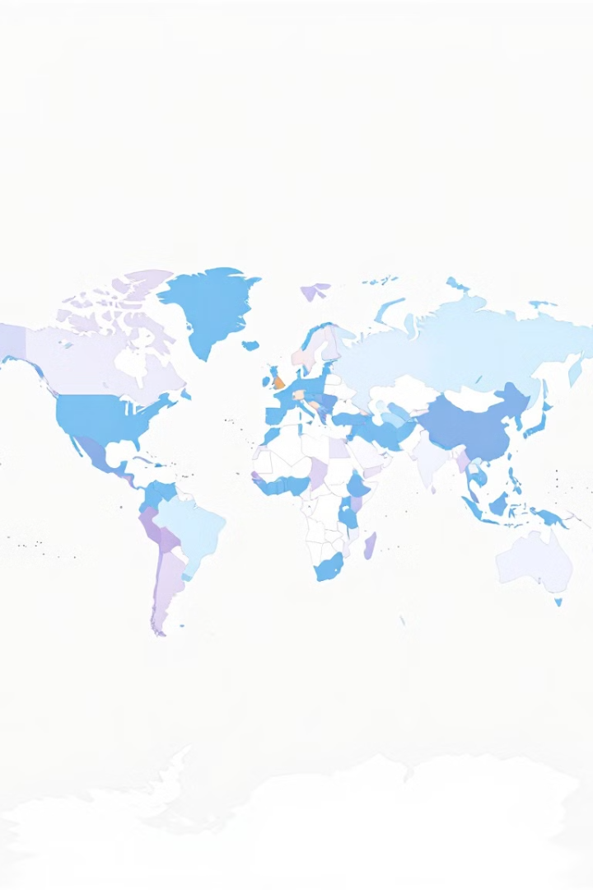
Data Sources
AI Index Data (2022)
Measures AI adoption across countries based on Talent, Infrastructure, Research, and Government Strategy.
World Health Data
Includes health expenditure (% of GDP) and life expectancy for each country.
Cleaning & Preparation:
Both datasets were cleaned and prepared for data visualisation and analysis.

Slide 7

Methodology
1
Step 1
Merge AI Index and World Health Data by country.
2
Step 2
Analyze correlation between AI adoption and health outcomes.
3
Step 3
Visualize data using a bubble chart.
X-axis: Life expectancy.
Y-axis: Health expenditure.
Bubble Size: AI adoption score.
Bubble Color: Represents different countries.

Slide 8
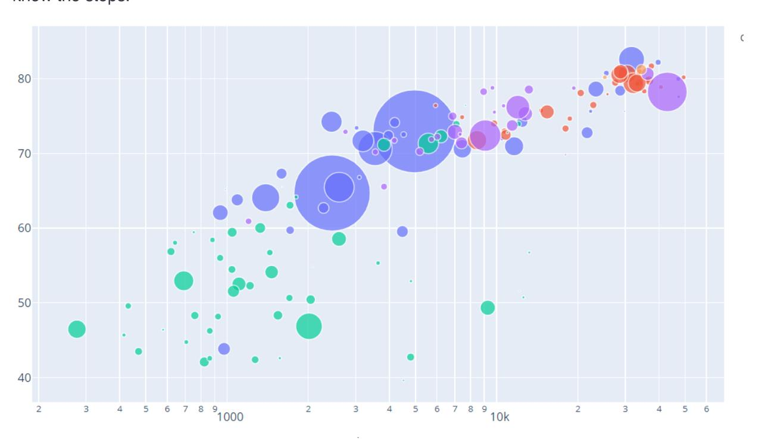
Data Visualization Bubble Chart
Health Score
Life Expectancy
Bubble chart showing correlation between AI adoption, life expectancy, and health expenditure across countries.

Slide 9
Correlation Analysis
Key Findings:
Countries with higher AI adoption (e.g., USA, China) tend to have better health statistics.
Some outliers may exist due to other factors (e.g. political situation, healthcare infrastructure, economic conditions).
Conclusion: Positive correlation between AI adoption and improved health outcomes.

Slide 10

Key Findings and Conclusion
1
Positive Correlation
2
Exceptions
Countries with higher AI adoption tend to have better health outcomes.
Some high AI adoption countries have lower health expenditure but maintain moderate life expectancy.
3
Recommendation
Encourage AI adoption in healthcare systems worldwide to improve health outcomes.

Slide 11



Appendix: Data Preparation and Tools
Data Cleaning
Visualization
Manual cleaning of the dataset for AI Index and World Health Data preparation.
D3.js and JavaScript

Slide 12
Conclusion
Summary:
AI has the potential to revolutionize healthcare by improving disease prediction and health statistics.
Countries with higher AI capabilities tend to have better health outcomes.
Future Work: Explore other factors influencing health statistics by visualizing data in different forms.
Sources
Data Sources:
AI Index Dataset (2022).
World Health Dataset (2022-2023).

Slide 13
THANK YOU!

